Slide 1
Tuning procedure PA_250
Leandro Souza

Slide 2
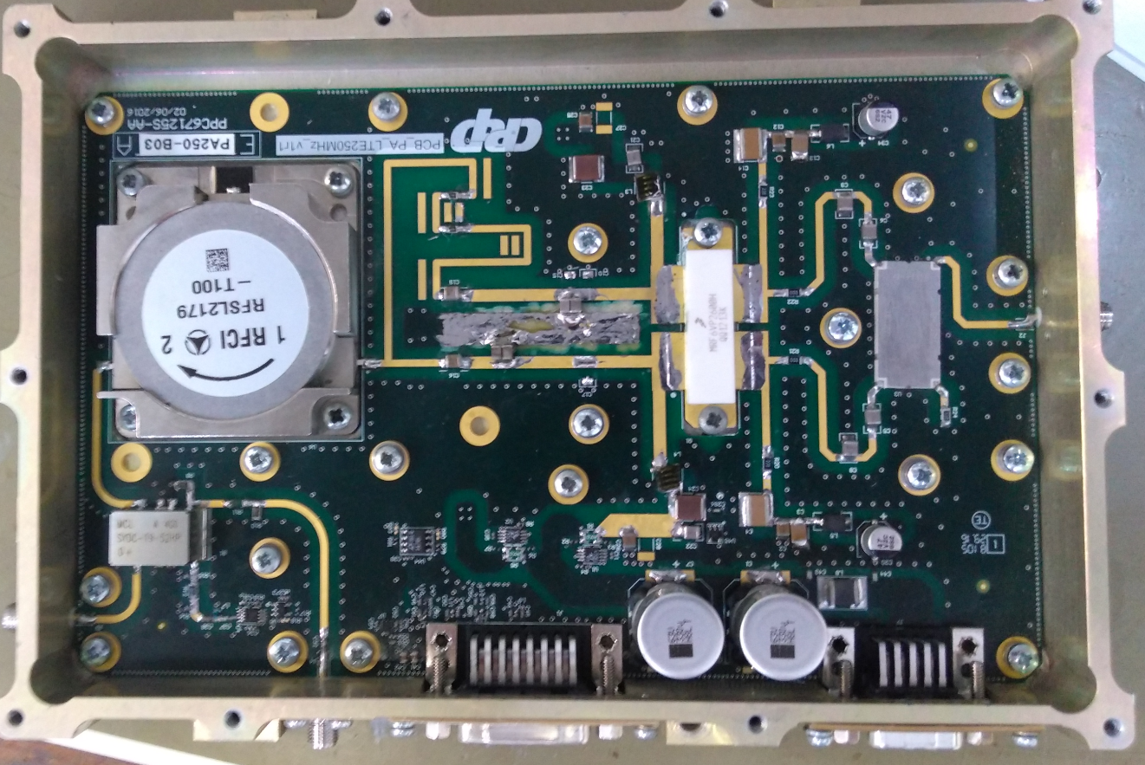
PA_250MHz
RF Input
RF Input
RF Input
RF output
90º Input hybrid
RF Feedback output
-4dBm +/-2dB
Input peak tuning caps
Peak transistor
tuning capacitors
Input main tuning caps
Main transistor tuning capacitors

Slide 3
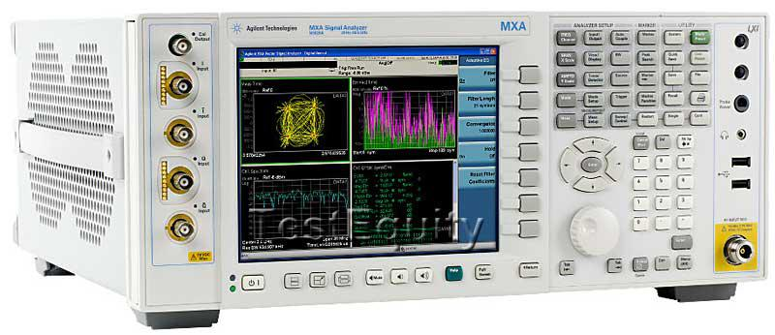
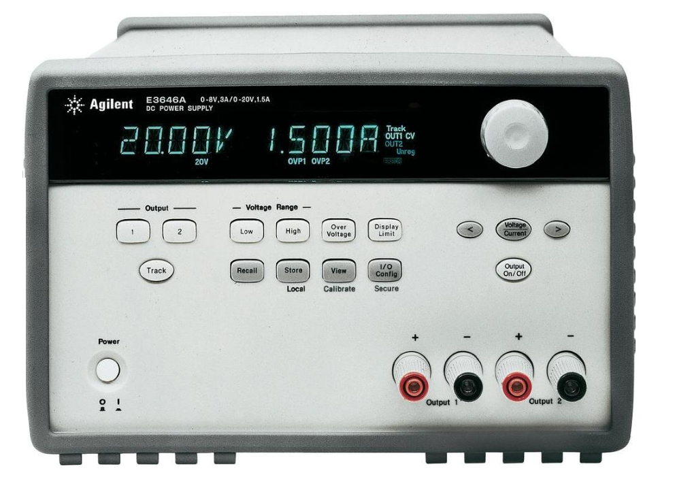
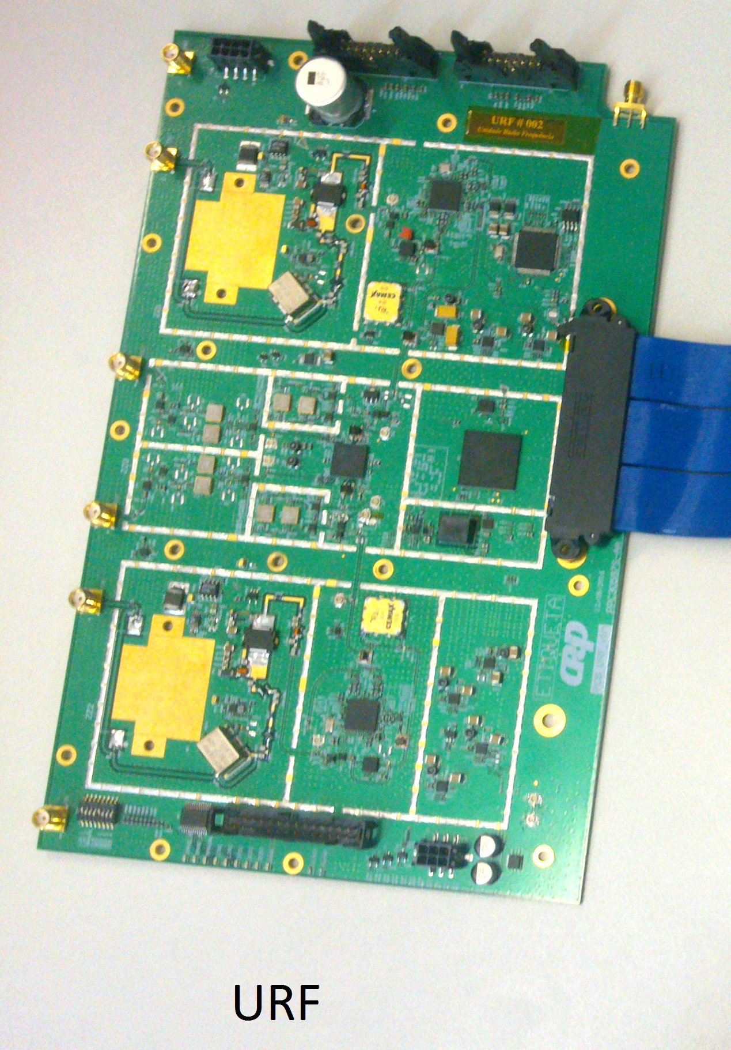
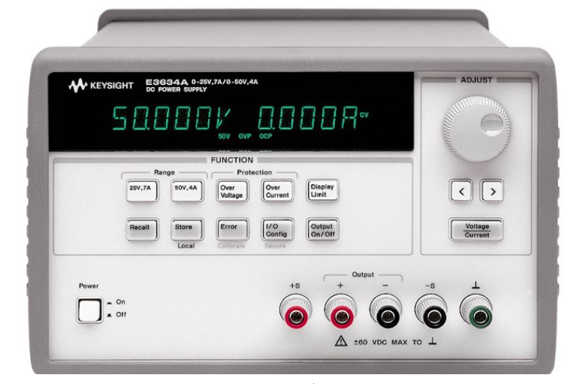
Necessary equipments
Keysight N9020A (MXA) Signal Analyzer
Agilent E3634A
Agilent E3648A
URF board, used as RF generator;
Warning: The operation of the URF's board , used as an RF generator, will not be addressed in this document;

Slide 4
Preparation Voltages and currents
RF
Generator
Spectrum
Analyzer
Isolator
40 dB
attenuator
Power
supply
Vgs Main
Vgs Peak
Power
Supply
45Vds
Vds 45V (power supply current must be 4 Amp or higher) → Agilent E3634A
Set Vgs peak 1.00V below Vgs main (example: Vgsmain 2.55V Vgspeak 1.55) → Agilent E3648A
Warning: Make sure that the PA's module dissipates the heat from your box somewhere, if it is on for an extended period of time.

Slide 5
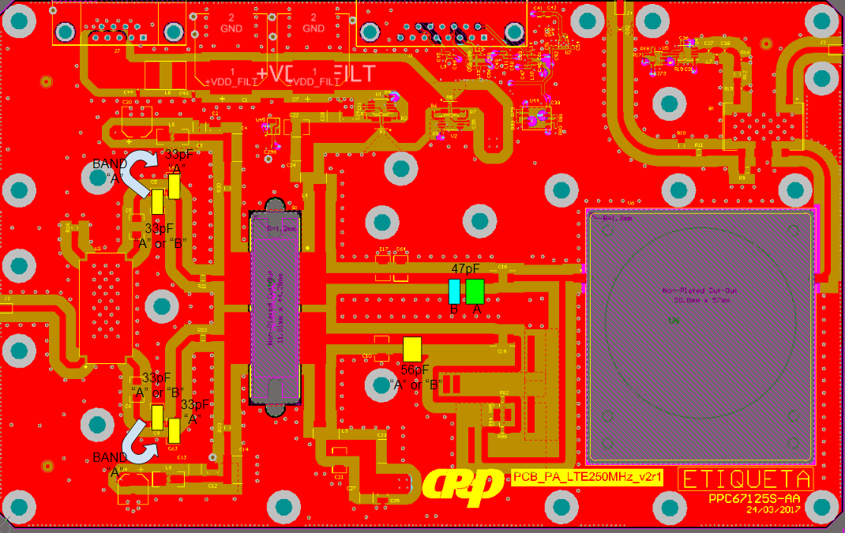
Tuning default
Default assembled capacitors: 47pF at main transistor output, 56pF at peak transistor output; 33 pF at peak and main transistors input; In the drawing below (PCB), the rectangles (yellow, green and blue) represent the area where the capacitors are to be tuned in each Band (A or B). The blue arrow shows the capacitor displacement of 33 pf to increase the power of the PA in band "A".

Slide 6
Turn on the Vds power supply; → Agilent E3634A.
Turn on the Vgs main and peak power supplies (Increase Vgs main up to reach Ids main 700mA); → Agilent E3648A.
Turn on the input RF signal (Test signal E-TM 1.1); → Use the URF's amplifier (25dBm up to 28dBm @ “>50dBc").
Measure the output power using a spectrum analyzer; → Keysight N9020A (MXA) Signal Analyzer (max. 45,5dBm).
Important:
1- Make sure that the URF's signal has ACLR better than 50dBc (25dBm up to 28dBm);
2- Adjust the position of the capacitors within the rectangular areas (Green, Blue and Yellow), as shown in the figure of the previous slide, until the following measures are reached:
→ ACLR better than 34dBc and Idc current (main current) below than 2.6A (adjust in 47pF) ;
→ CCDF compression better than 9dB at 0.001% (adjust in 56pF );
→ Maximum output power (+45.5 dBm) (adjust in 33pF);
Tuning steps

Slide 7
Failures
After all the adjustments made, if there are ACLR, CCDF and / or Power Output faults, there will probably be problems with the active element mounted on the PA's circuit, that is:
→ The Transistor may not be dissipating heat in the box;
→ The transistor may have its parameters changed due to other possible problems :
Component batch failed. The transistor has some intrinsic parameter modified at the factory;
Due to manipulation of the transistor when removing it from the package (static electricity);
Due to the assembly and welding process of the transistor on the board (excess welding and temperature);
Due to the time the transistor was subjected to the generated heat without dissipation in the box, with transistor turned on;
Due to the excess power at the module input, with transistor turned on;
Due to distortions arising during the adjustment procedure, with transistor turned on;
Due to antenna mismatch at module output, with transistor turned on;
Other more...;
Solution:
The cases presented do not necessarily prevent the transistor being used, however, a new adjustment of capacitances would be necessary in the lines. Values ​​and / or capacitor positions may have their results changed. In order for this type of adjustment to be possible, the guidance of an RF Engineer (or experienced RF Technician ) is indispensable.
Typical measured values for ACLR (with and without linearization), CCDF and power output are shown at the next slides

Slide 8
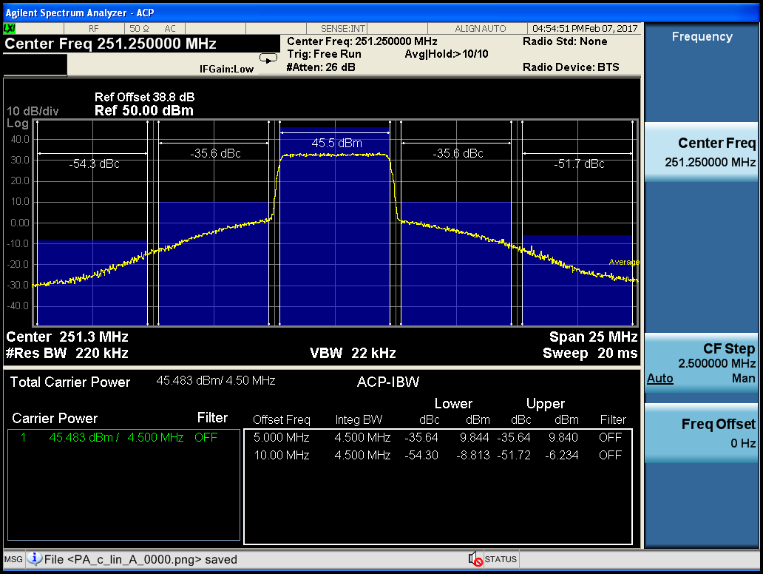
ACLR and Output power

Slide 9
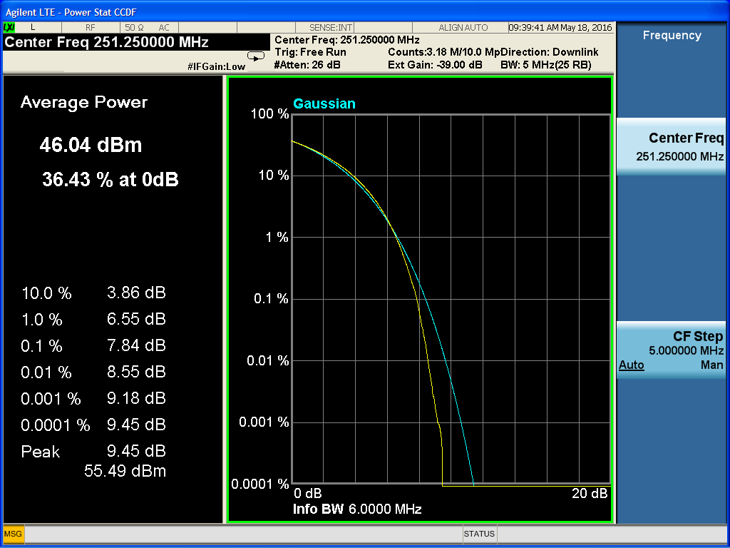
CCDF@ 45.5 dBm

Slide 10
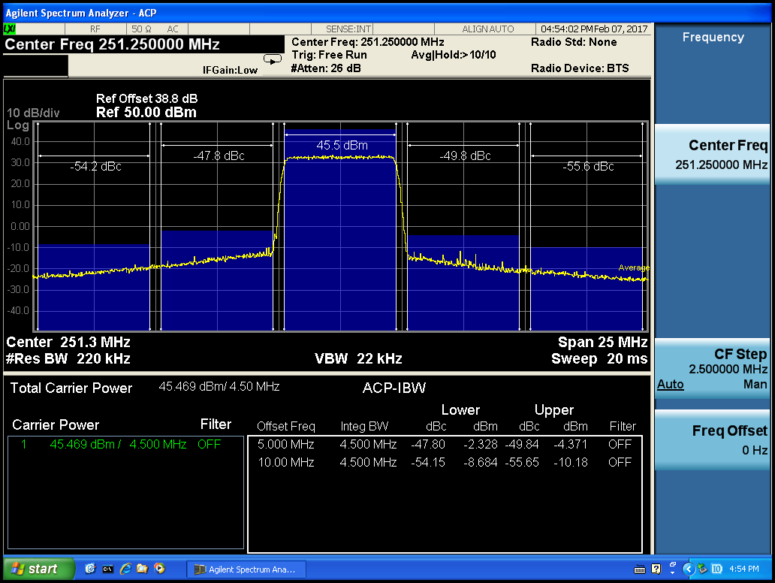
ACLR with Linearization @ 45.5 dBm

Slide 11
THE END

